Slide 1
The 2020 Presidential Election Campaign
Postscript

Slide 2
Campaign Controversies
Issues/Events
That May Have Potentially
Affected the Election Outcome

Slide 3
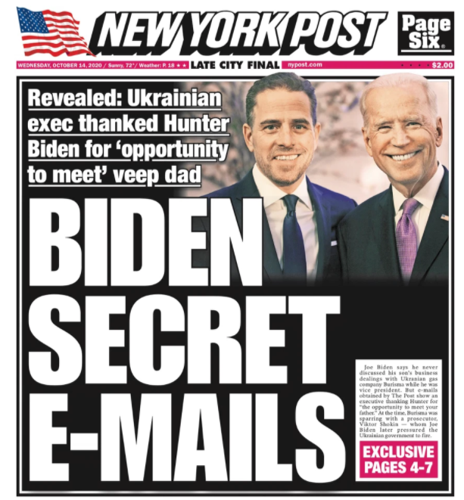
Joe Biden’s Corruption as VP??
Hunter Biden’s Lucrative Deals (Original Slide: Pre-Election)
Joe Biden-Hunter Biden
Corruption?
Did Joe Biden use his influence as VP to help his son, Hunter, gain lucrative deals in Ukraine, China, and elsewhere??
Twitter and Facebook censored the New York Post story, believing it to be corrupted by Russian intelligence interference in U.S. Elections
Conservatives news outlets, such as Fox News, have advanced this story as true, that a laptop, allegedly containing Hunter Biden’s emails was turned over to the FBI
Critics believe this story is false, a product of Russian disinformation
Will allegations of corruption hurt Biden’s chances of becoming president?
Notes:
https://nypost.com/2020/10/14/hunter-biden-emails-show-leveraging-connections-with-dad-to-boost-burisma-pay/ -- The story was published on 10/14/2020.

Slide 4

Joe Biden’s Corruption as VP??
Hunter Biden’s Lucrative Deals (New PostScript Slide)
In October 2020, the dominant media outlets rallied to protect Joe Biden from a potential scandal
Twitter and Facebook censored the New York Post story, published in October 2020, just weeks before the 2020 presidential election, believing it to be corrupted by Russian intelligence interference in U.S. Elections
The New York Times characterized the Hunter Biden laptop/email controversy as a product of Russian disinformation
In March 2022, 17 months after the story was first published in the New York Post, The New York Times, a more prestigious paper and a competitor, admitted that the Hunter Biden laptop story and email leaks were true and valid, conveniently, when it was “safe” to do so (i.e., long after the 2020 presidential election)
Notes:
'Intelligence' experts refuse to apologize for smearing Hunter Biden story (nypost.com)
https://nypost.com/2022/03/18/intelligence-experts-refuse-to-apologize-for-smearing-hunter-biden-story/?msclkid=7e4be9ecaa6f11ecb024d899f224c9e9
REPORT: Rep. Ro Khanna Was The Only Democrat To Raise Issue With Twitter Nuking Biden Laptop Story (msn.com) https://www.msn.com/en-us/news/politics/report-rep-ro-khanna-was-the-only-democrat-to-raise-issue-with-twitter-nuking-biden-laptop-story/ar-AA14QNoN?ocid=msedgntp&cvid=2d12b107bb664d25baf4928723a9c91f – Ro Khanna, a Democratic member of the U.S. House, was the only Democrat to question Facebook’s and Twitter’s suppression/censorship of the Hunter Biden story prior to the 2020 presidential election.

